Slide 1
Carnarvon Science Fair
2025

Slide 2
What is a science fair?
A science fair is a showcase where students exhibit their scientific projects, experiments, or research.
These events, ranging from classroom to international levels, provide students with an opportunity to explore scientific concepts, conduct research, and present their findings to judges, peers, and sometimes families.
Science fairs can be competitive, with prizes awarded for the most outstanding projects.

Slide 3
Research question:
A science fair project will often have a research question, for example:
Which age group are the friendliest?
Can you make a hover craft at home?
From which side of the football pitch can you score more corners?
Which chocolate melts the fastest?

Slide 4
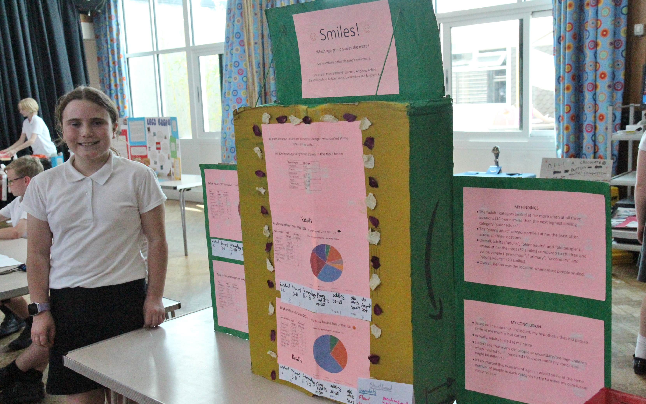
Some of last years projects:
The winner:
She tested which age range is most friendly, by going to public places, smiling at strangers and seeing who smiled back!

Slide 5
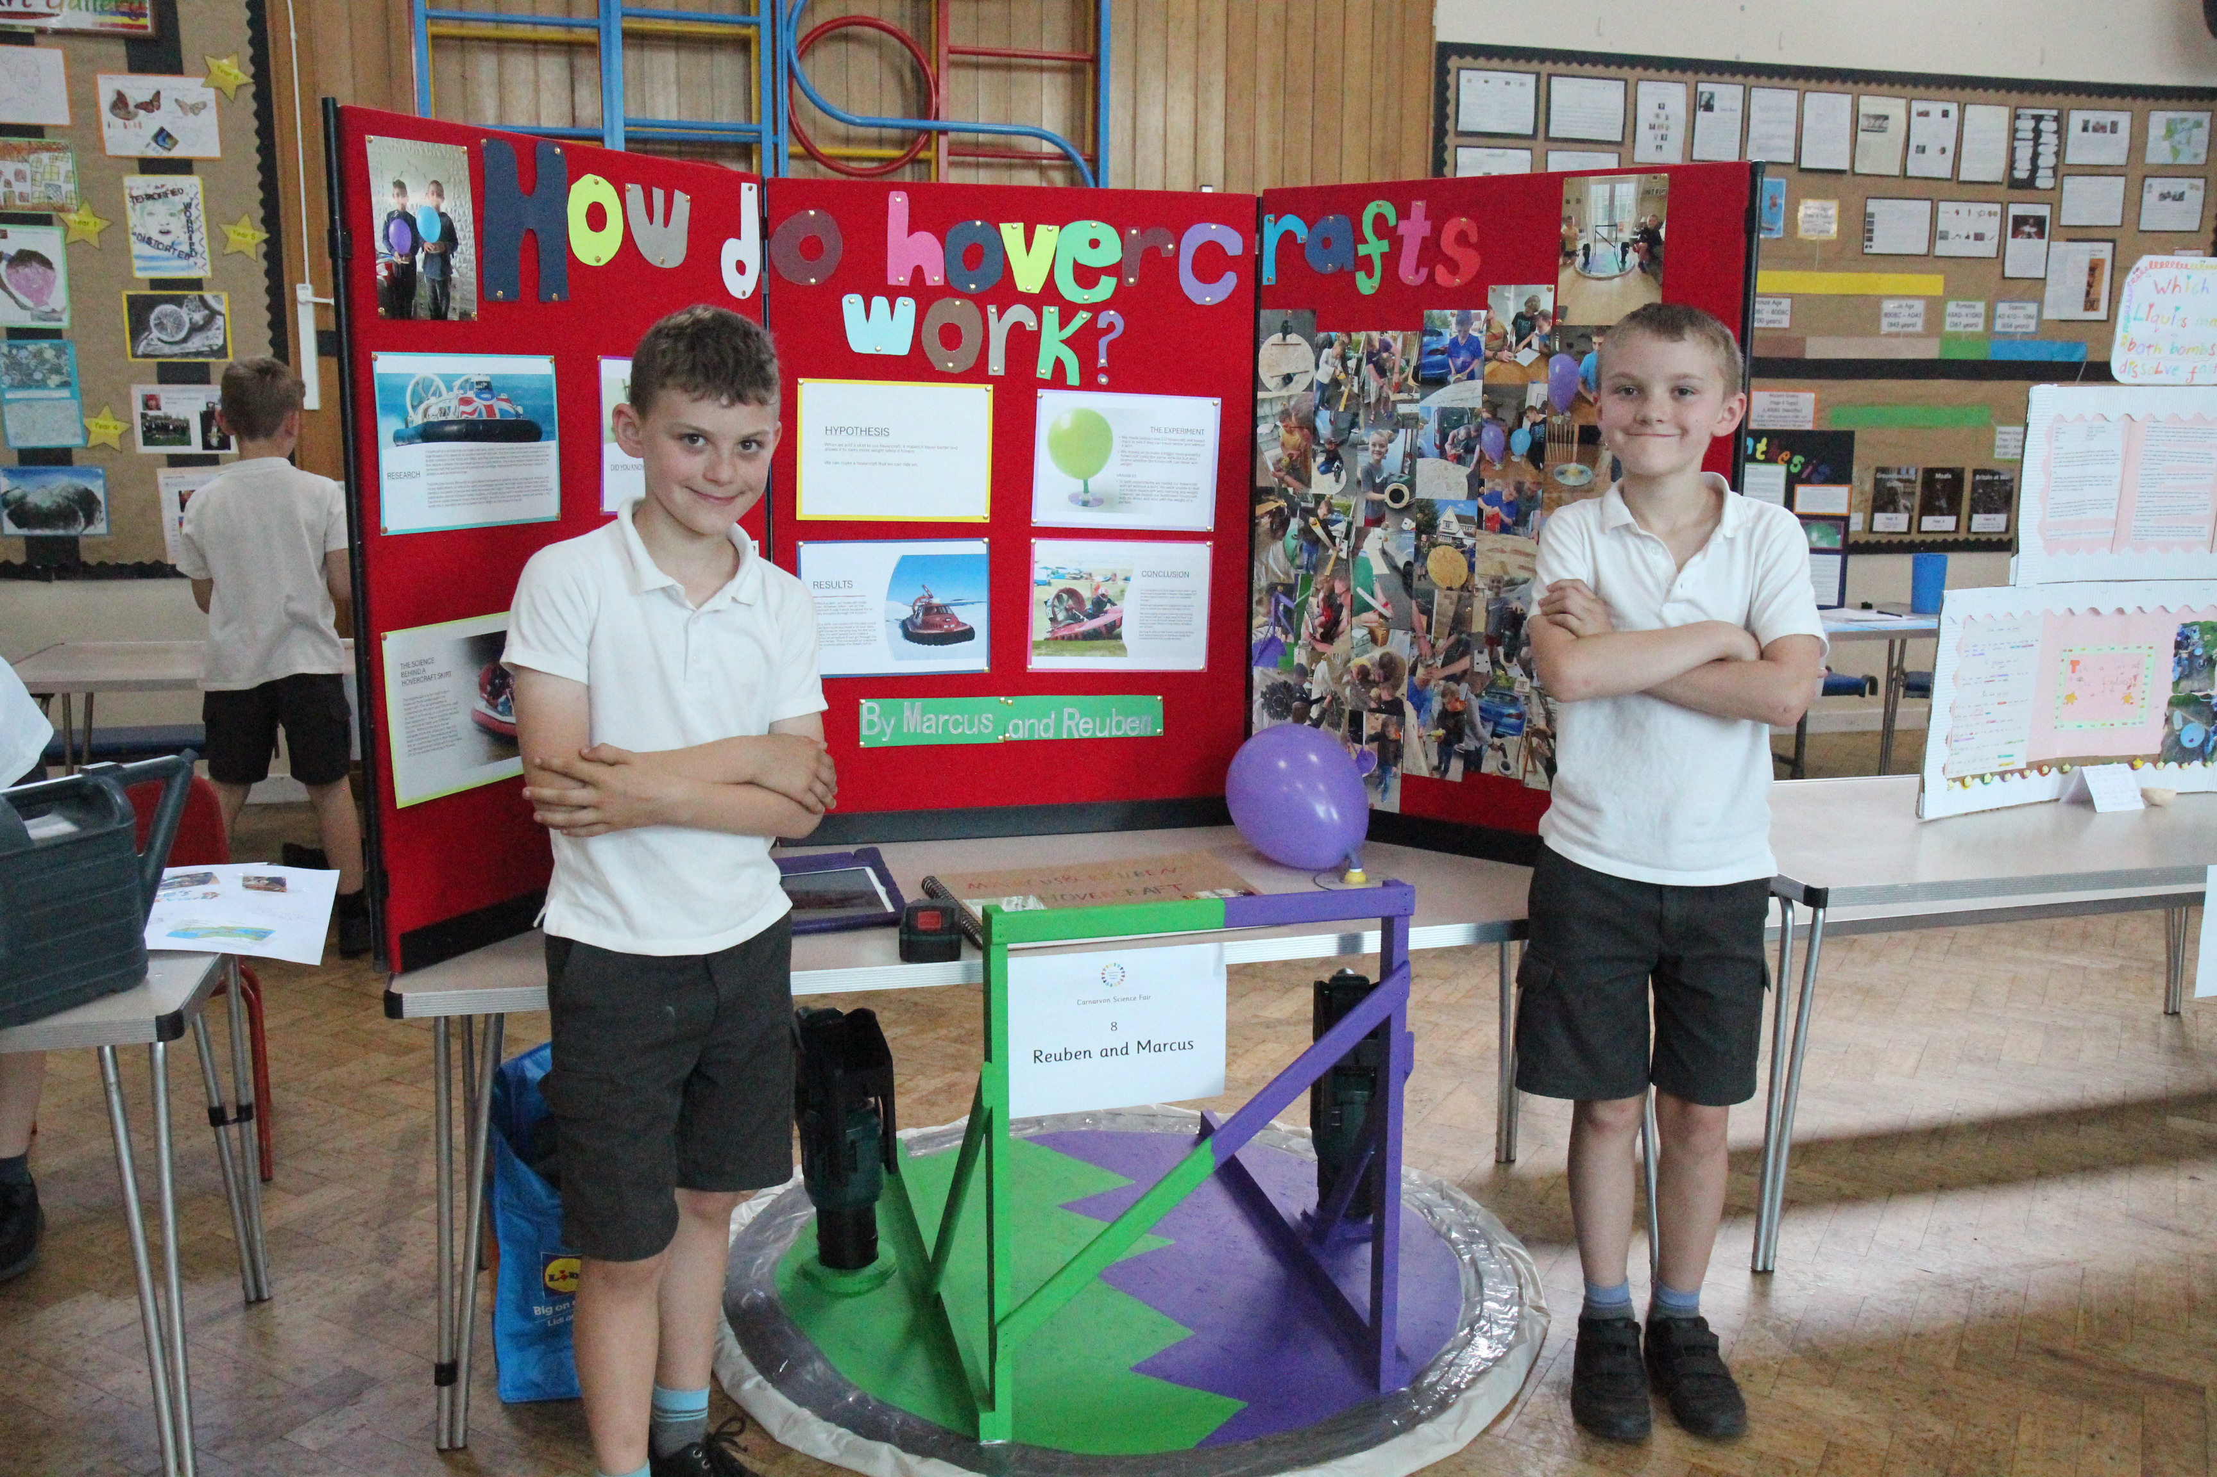
The runner up
The boys designed and made their very own (working) hovercraft using leaf blowers!

Slide 6
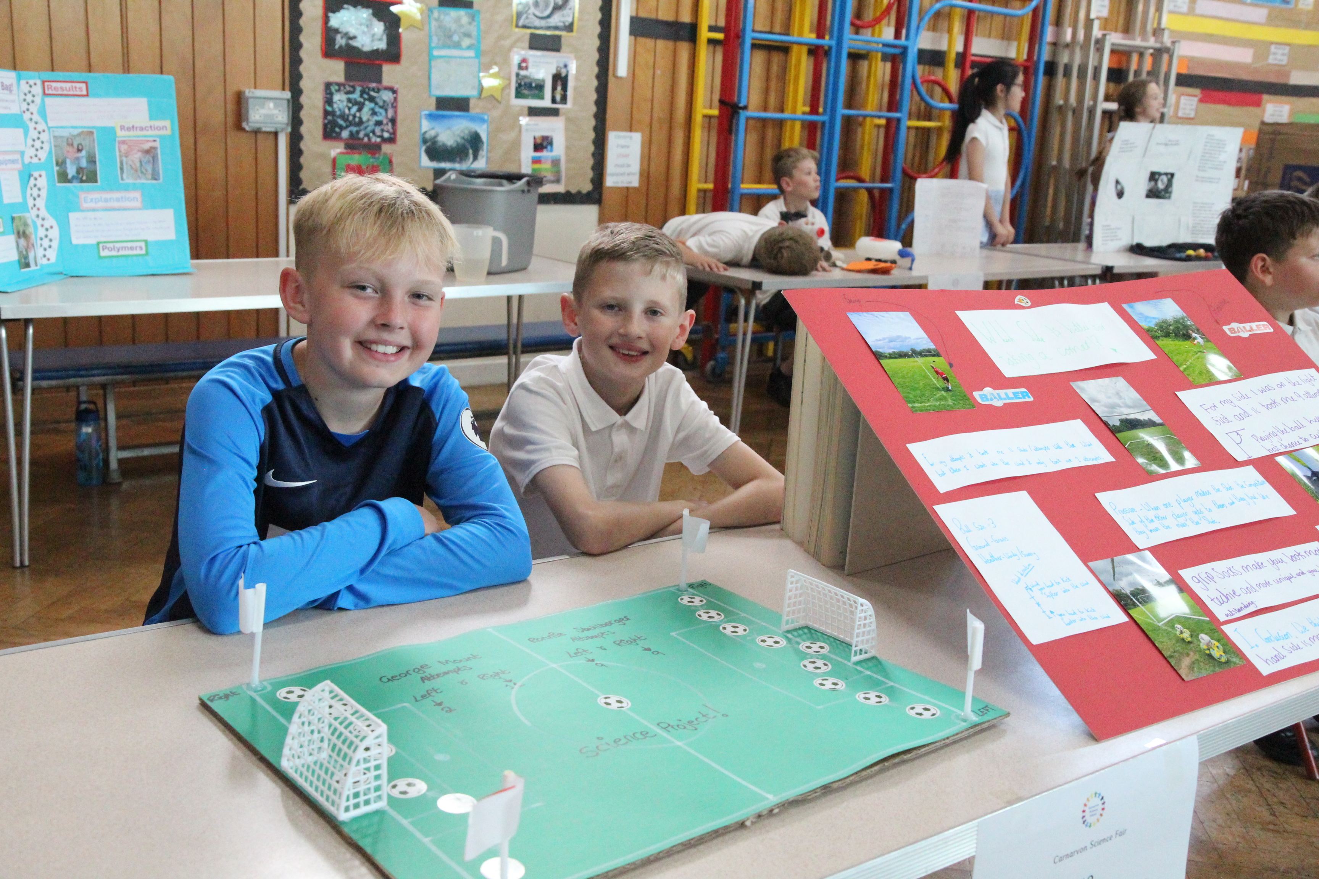
These boys tested from which side of the football pitch you are most likely to score a corner

Slide 7
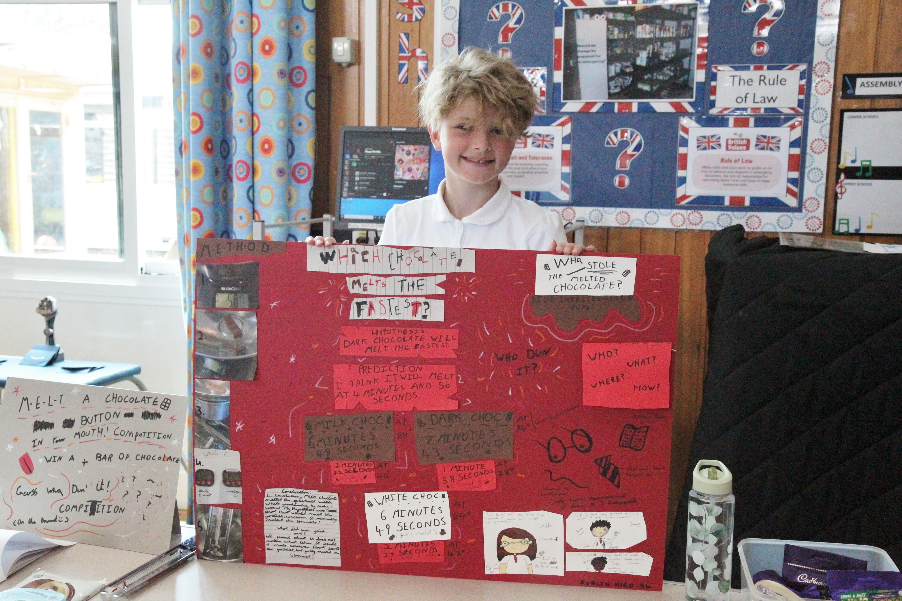
This project tested which type of chocolate melts the fastest.

