Slide 1

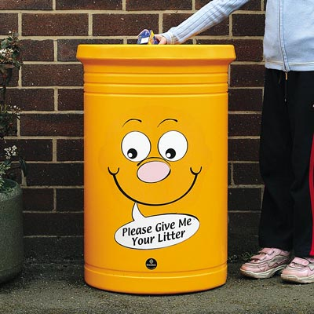

The Fantastic Litter Pickers
By the Litter Picking Patrol

Slide 2
What We Do
Every Tuesday and Thursday a team of Litter Pickers from Year 4 and Year 5 go out and pick up a lot of litter.
We find:
Sweet wrappers
Milk cartons
Straw wrappers
Foil
Plastic
We help to keep the world clean and healthy by litter picking.

Slide 3
Why Littering Is Bad
Animals can think that litter is food and they can try to eat it. The litter could kill them.
Litter takes a long time to dissolve.
It is expensive to clear up litter and sometimes difficult.
It is harmful to people, plants and animals.
Littering is also bad because it is illegal. People who litter can be fined and charged.

Slide 4
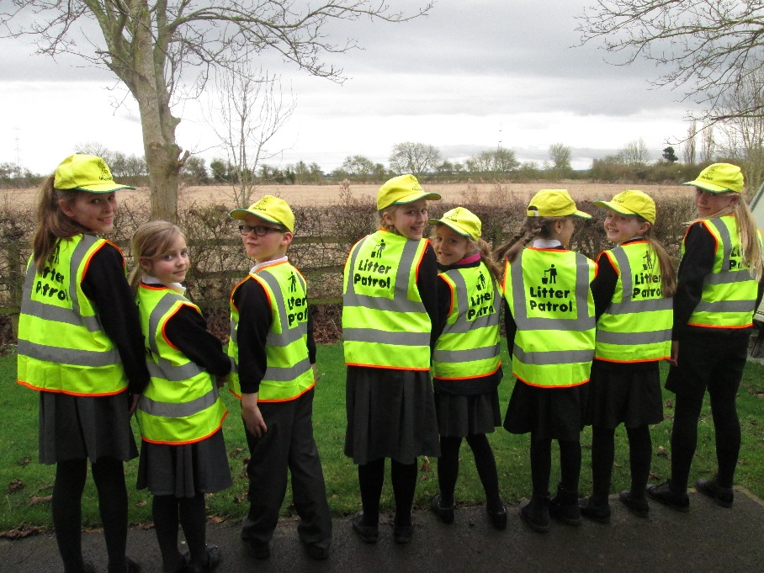
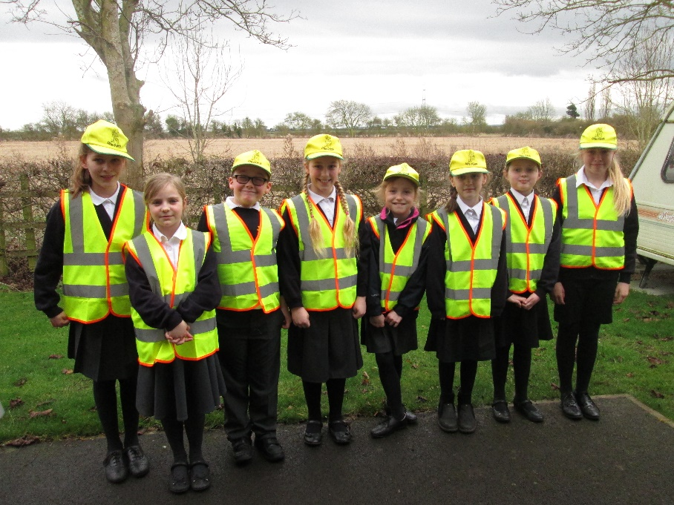
You Can Help By:
Being careful and putting litter in the right bin.
Not Disturbing us. We are the litter pickers not you.
Not dropping litter on the floor.

Slide 5


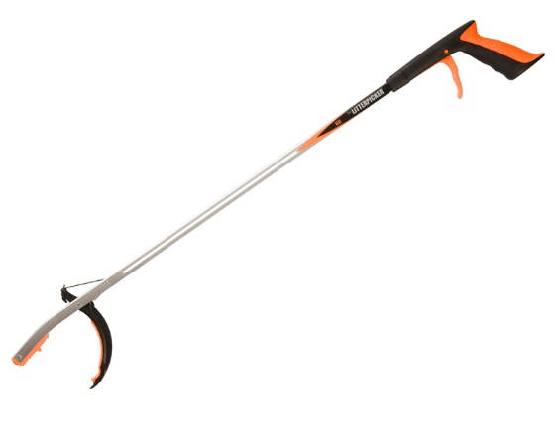
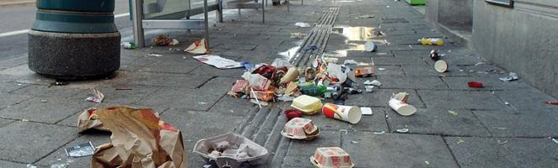
Thank you for listening and watching our presentation.
Are there any questions you would like to ask us?

