Slide 1

Welcome to year 5
5L and 5T

Slide 2
Members of staff
Miss Titley (5T)
Mr Lloyd (5L)
Miss Flowers is in year 5 full time and will support across the classes.
Mr Evans, Mrs Lewis, Mrs Johnson and Miss Howells will also be supporting at various points in the week in both classes.
Mr English will be in on Wednesday afternoons doing PE with both classes.

Slide 3
Morning routine
8:45am – doors open and children to come into the classroom from the Cawthra playground, not from the front of the Cawthra building.
There is no supervision on the playground before school so please wait with your child. Children are not to play on the field at all please as it brings mud/wet grass into the classrooms. They are also not to play in the ballcourt or on the trim trail.
Water bottles are kept on their tables.
Coats/bags on pegs (children have their own number which they know)
Lunchboxes on trolleys (outside 5Ls door in the morning)
Snacks in bag
Planners and reading books in school every day- this is particularly important on a Friday as this is when spellings are given out and stuck in.

Slide 4
End of the day routine
School ends at 3:30pm- collection is from the Cawthra playground.
Children to take lunch boxes, water bottles, planners and reading books home each day.

Slide 5

Autumn term
  Our overall all topic for this term is Dynamic Dynasties.
  In Topic we’ll be looking at the Shang Dynasty (Bronze Age China).
  Science – Forces and Earth and Space
  PE will be taught by Mr English on Wednesday, so children need to come dressed in PE kit.
  Parents’ Evening will be in November, with the date to be confirmed.
  Forest School sessions with Miss Galbraith– 3 sessions each class dates for each class to follow.
  We will also have the annual Year 5 Yule log decorating competition around Christmas time.

Slide 6
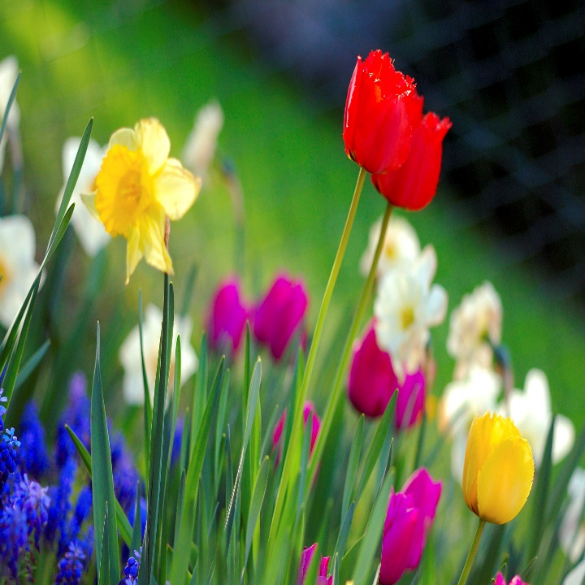
Spring term
  Our main topic is geography focused and we will be looking at farming, food and land use.
  We are also hoping to go on a trip to the allotments in Bingham and to the eco farm in Screveton.
  In science, we will be learning about human reproduction and the ageing process.
  We are hoping to go to Toot Hill and use their kitchen classrooms to make seasonal soups, we have done this each of the last two years and it was excellent!

Slide 7
Summer term
  Our main topic is Ancient Greece. The children will find out all about ancient Greece and write their own Greek myths, odes and Greek playscripts. We had a Greek Olympic day which we will be doing again this year.
  In science, we will be looking at properties of materials.

Slide 8
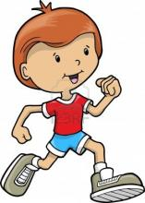
Pe
Wednesday afternoons
  Suitable for all weather types
  Children to come to school wearing kit
  No earrings (or a plaster covering if newly pierced)
  Hair tied back
  Extra socks
  PE kit is a plain white t-shirt, with no designer brands please.
  When it is cold, they can wear their school jumper on top of their PE kit.

Slide 9
spellings
Given out on a Friday (starting Friday 6th).
Children will be given spellings and tested the following Friday (some children will be continuing with personalised spellings like they had last year)
The spellings usually follow a spelling rule which will be taught in our spelling lesson but there may be additional spellings too.
Children have a login for ‘Spelling Shed’, where they will be able to access games related to their weekly spellings (starting Friday 13th).
Spellings will also be glued into planners each week.

Slide 10

homework
Homework will be set on a Friday and submitted the following Friday (Starting Friday 20th).
Homework will often be set using Mathletics or TT Rockstars which will recap on our previous learning. It will also include reading comprehension, writing activities or research activities.
Please encourage your child to use Mathletics and Times Table Rockstars regularly (login details are stuck in their organisers) even when it is not set for homework.
Please sign organisers at the end of the week.

Slide 11
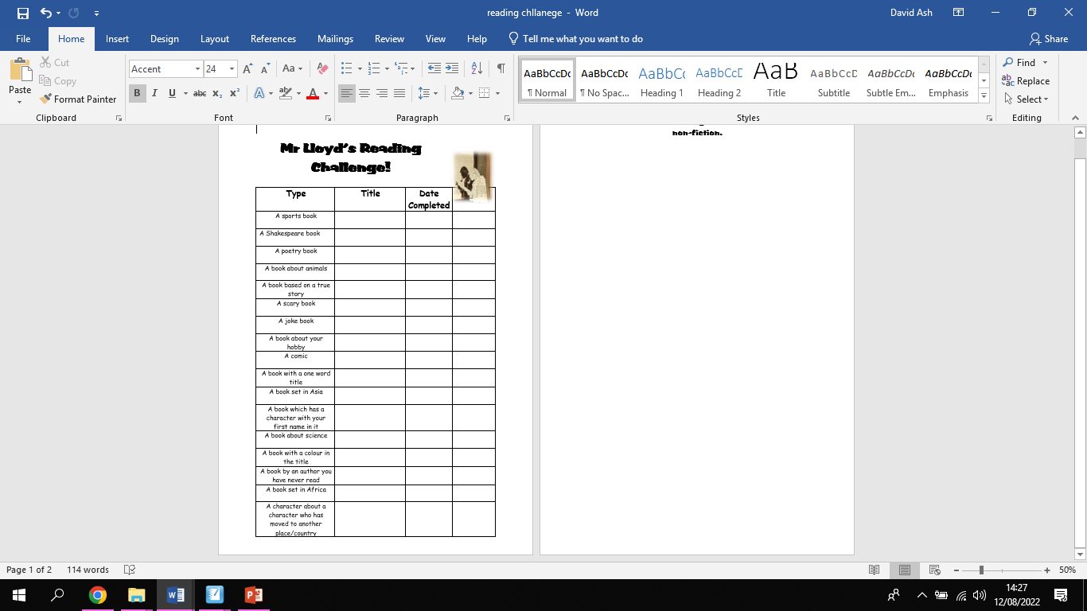
Year 5 Reading Challenge
Both classes have a reading challenge for the children to try and complete.
They will be stuck in their organisers next week.
Please sign to say when the children have completed each section.
The aim is to encourage reading.
Once they have completed the list, they will go into the class ‘Hall of Fame’.

Slide 12

expectations
Increased levels of maturity/independence
Organisation
Reward systems in both class
‘Work hard be kind!’

Slide 13

E-safety
Confidentiality – including social networks for Sports Day/Plays.
Please do not post photos or videos of other people’s children online as per the school policy.

Slide 14
Has anyone got any questions?

