Slide 1
Meet The Teacher
Carnarvon Primary School
Year One
July 2025

Slide 2
Welcome to Year 1
We are so excited to be working with you and your children this year.
Please e-mail us via the office email if you need to contact us or let us know any information. We will get back to you as soon as we can.
Birthday sweets, if you would like to send in some treats for your child’s Birthday then we will be happy to put them in their bags for them and you can decide whether to open them at your discretion.

Slide 3
Overview
Staffing
Daily routine
The transition from Foundation to Year 1, cloakroom and bags
Phonics
Reading
Writing
Topics covered
PE –Wednesday – PE kits
E-safety / School Website/Twitter

Slide 4
Year 1 Staff
Teachers
Teaching Assistants
Mrs Batchlor and Ms Wrate – 1BW
Mrs Sadler and Mrs Cork – 1CS
Mrs Clarke
Mrs Booth
Mrs Fozard

Slide 5
Daily Routine
At the moment we operate in a very similar way to reception with the children accessing lots of enhanced provision (activities set up around the classroom) whilst the adults work with small groups.
Mornings have 2 activities either maths/ English and phonics and then a topic style activity in the afternoon.
We are also getting used to playing with the toys/equipment and our classroom peers in year 1, so we spend a lot of time modelling how to do something.
Milk and fruit is given out at morning play – please ask at the office if your child wishes to have milk.
We continue to be in the routine of washing hands before eating lunch.
Playtimes are out on the ‘big’ playground, OPAL lunchtimes
Afternoons are spent on another topic based activity – our days are full of fun and busy!
We have another afternoon play and then finish every day with a story.

Slide 6
The transition
We try to do work like Reception until Christmas time. After Christmas we begin to start working more as a whole class with less ‘choosing time’.
We build up to this and we have done this successfully for a long time at Carnarvon.

Slide 7
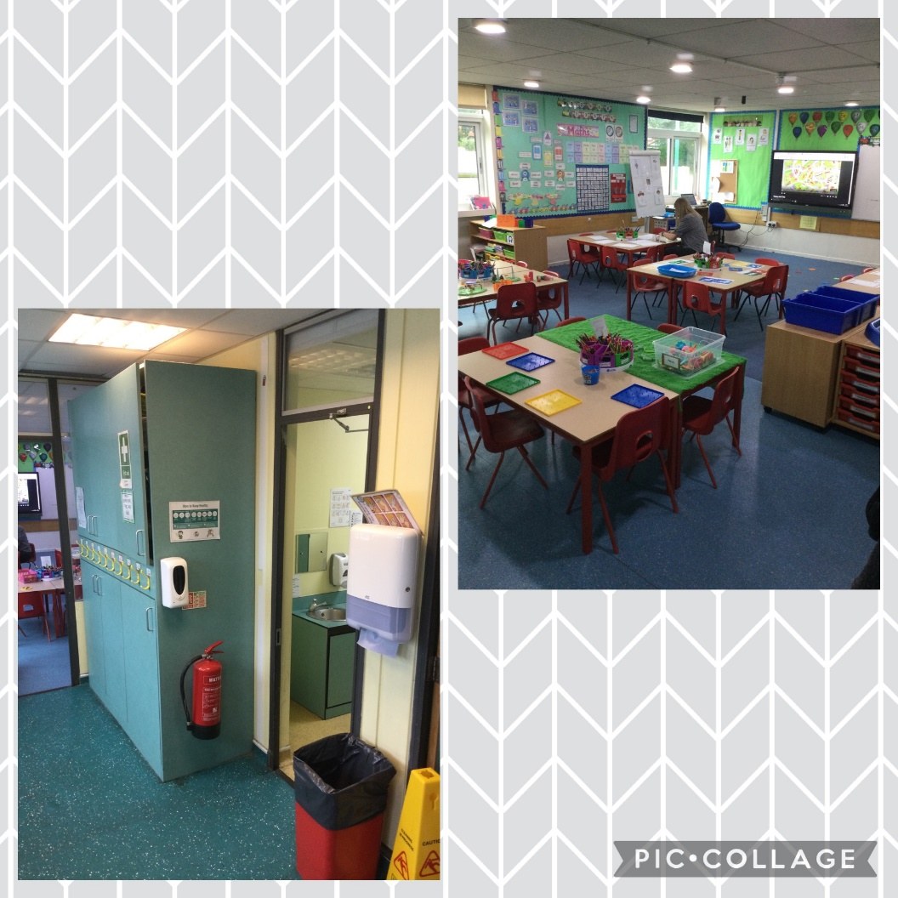
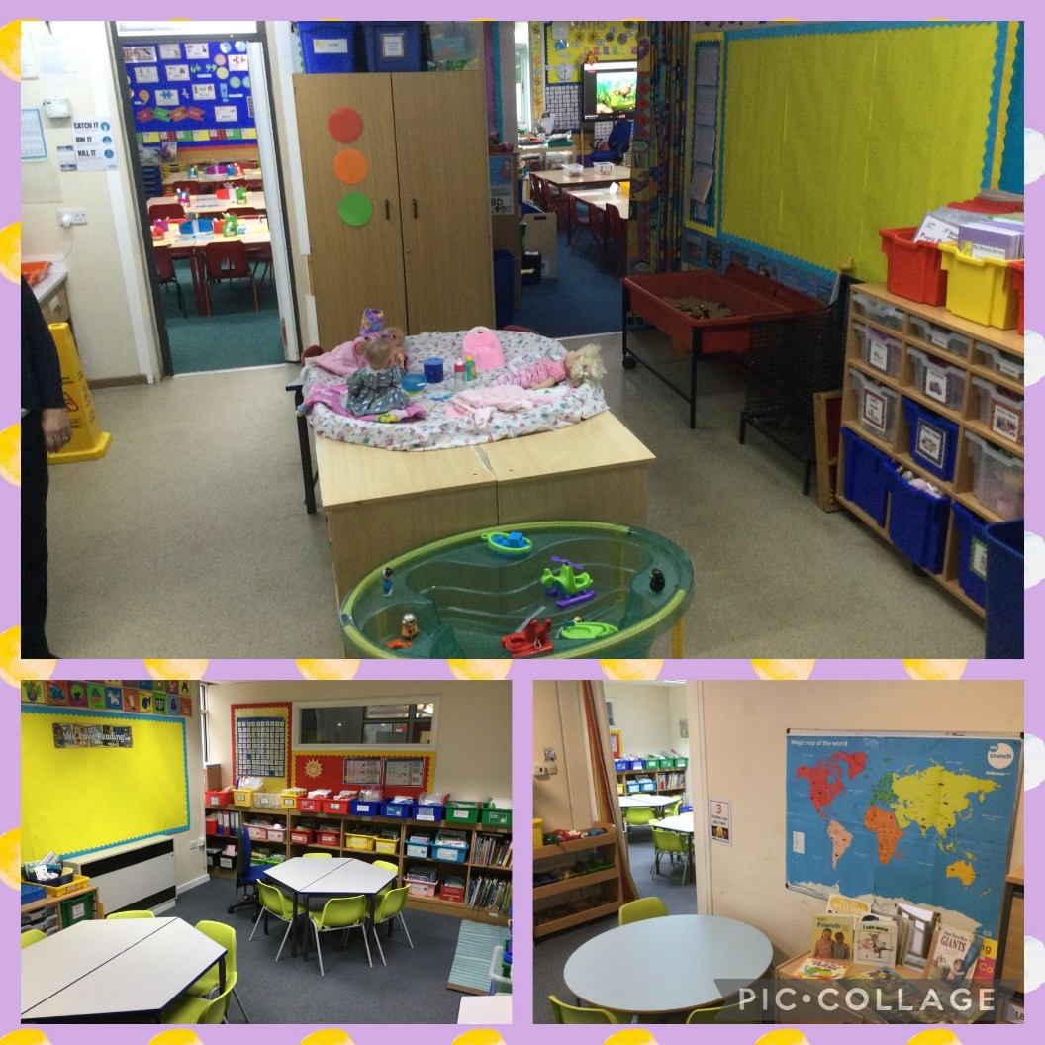
Year 1 area

Slide 8
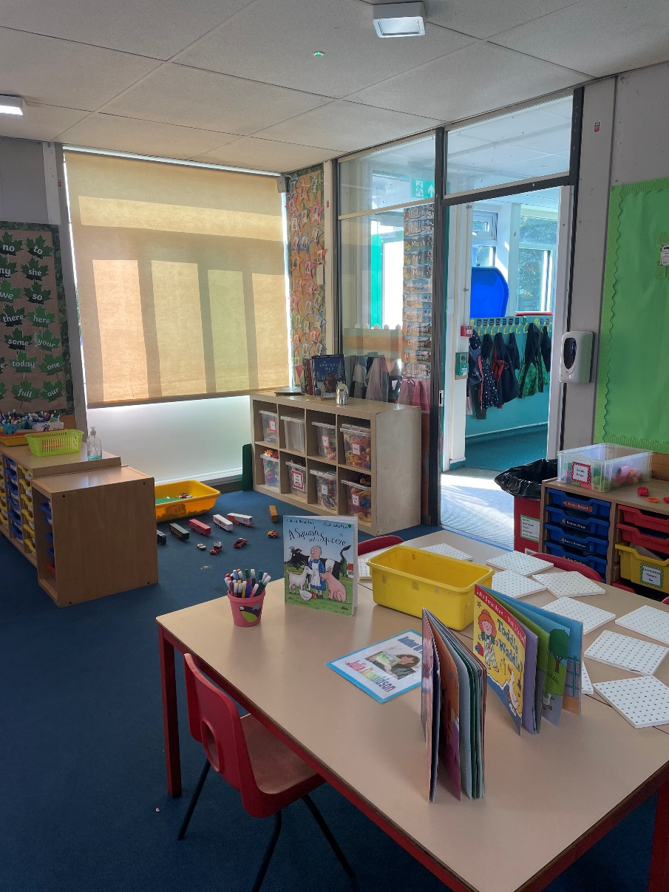
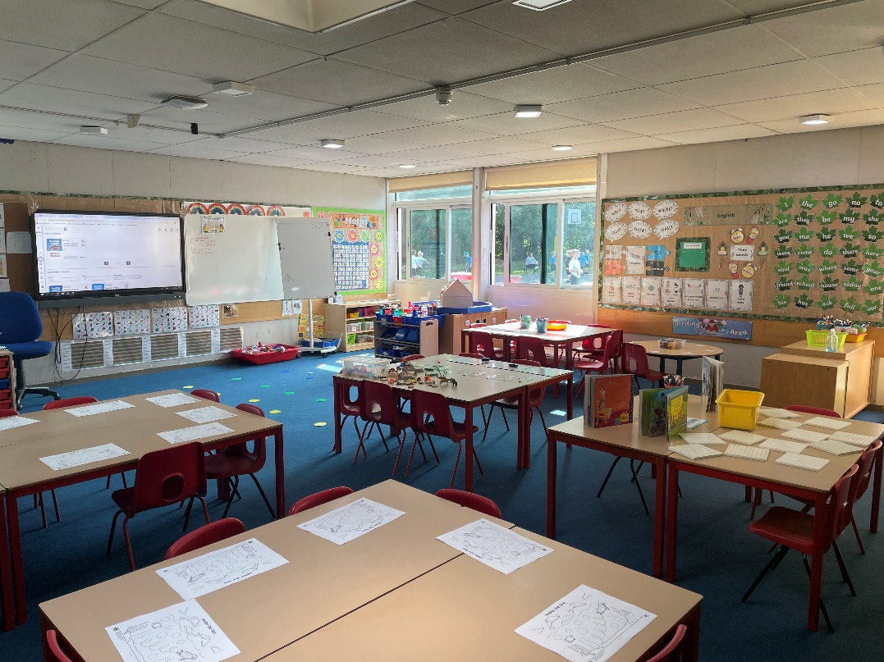

Slide 9
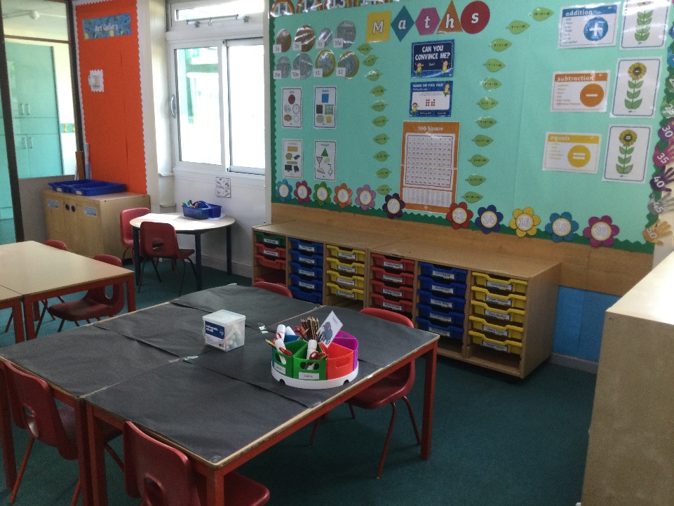
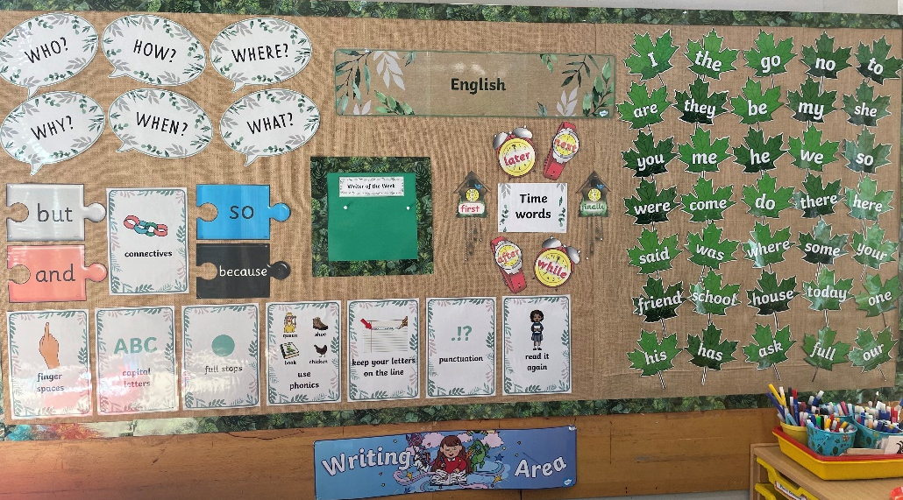

Slide 11
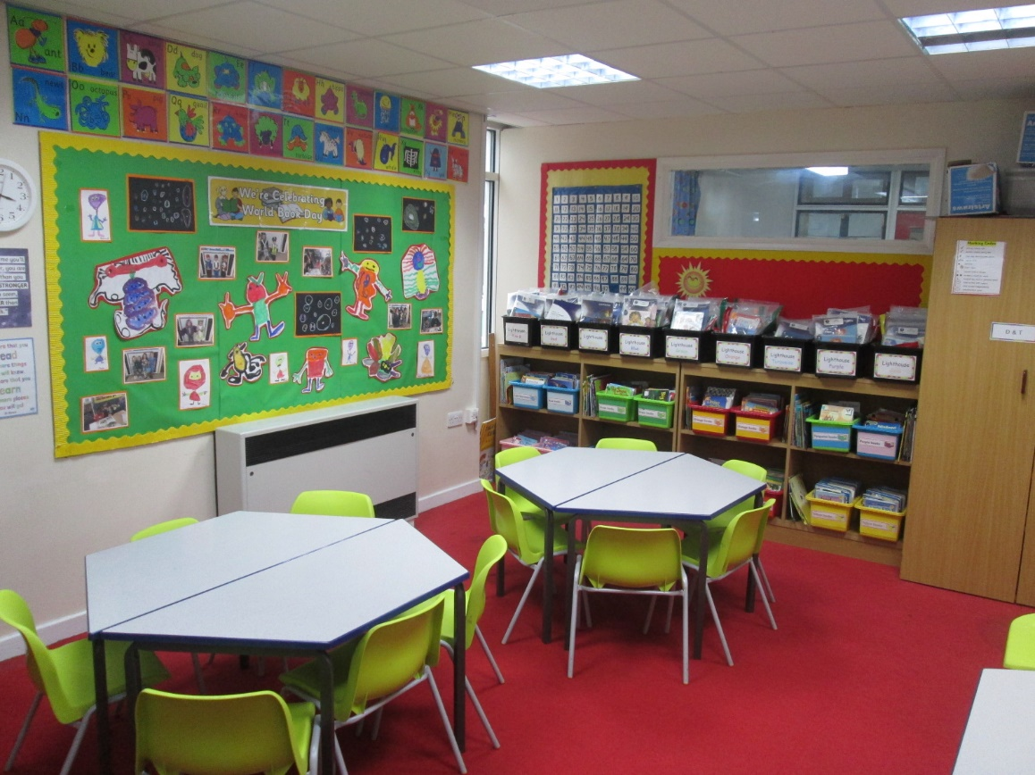
Year 1 area
Reading area

Slide 12
Phonics
Each week the children will revise and learn two new phonemes and 1-2 high frequency words.
The important principles of Rocket Phonics is whole class teaching so every child has access to the same phonics teaching with extra support if needed.
The emphasis is on keeping up, not catching up.

Slide 13
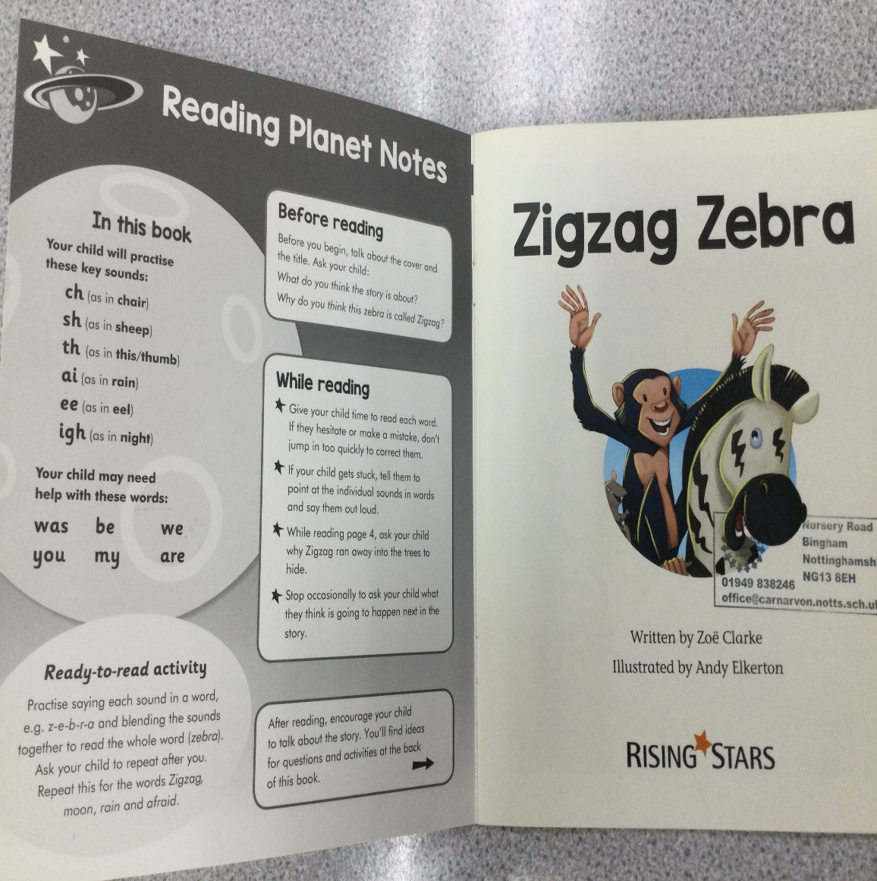
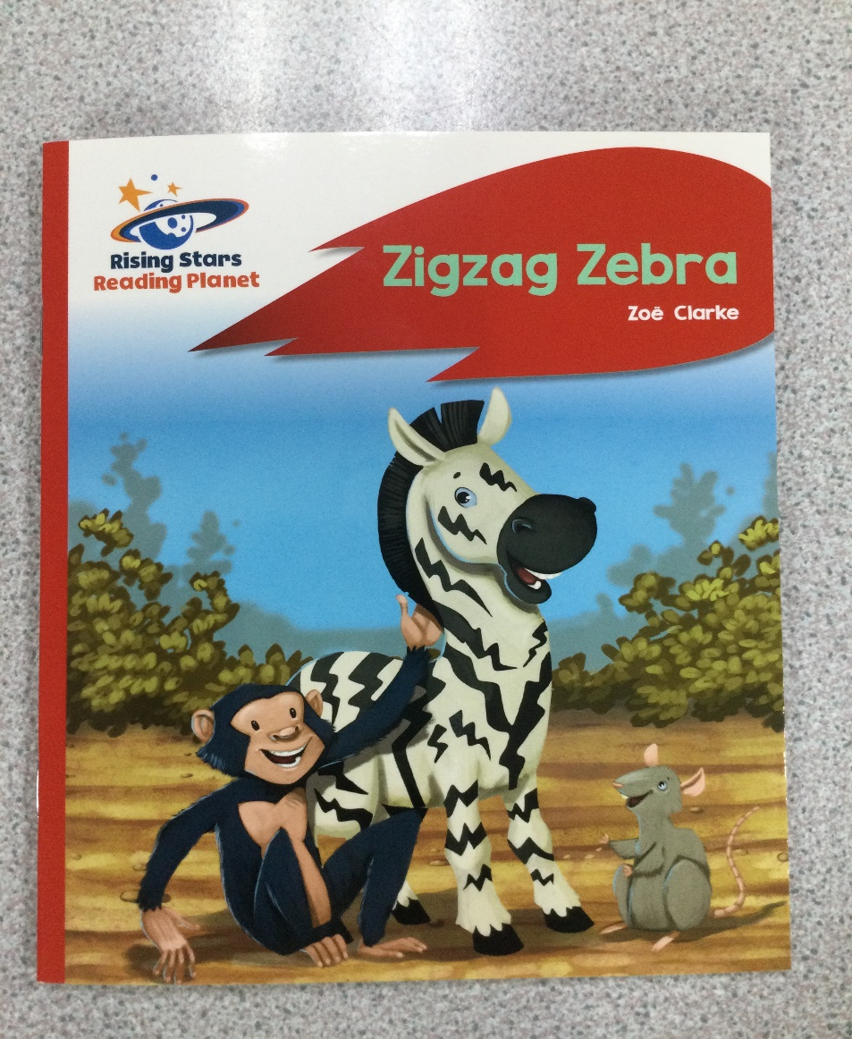
Reading books – Rising Stars

Slide 14
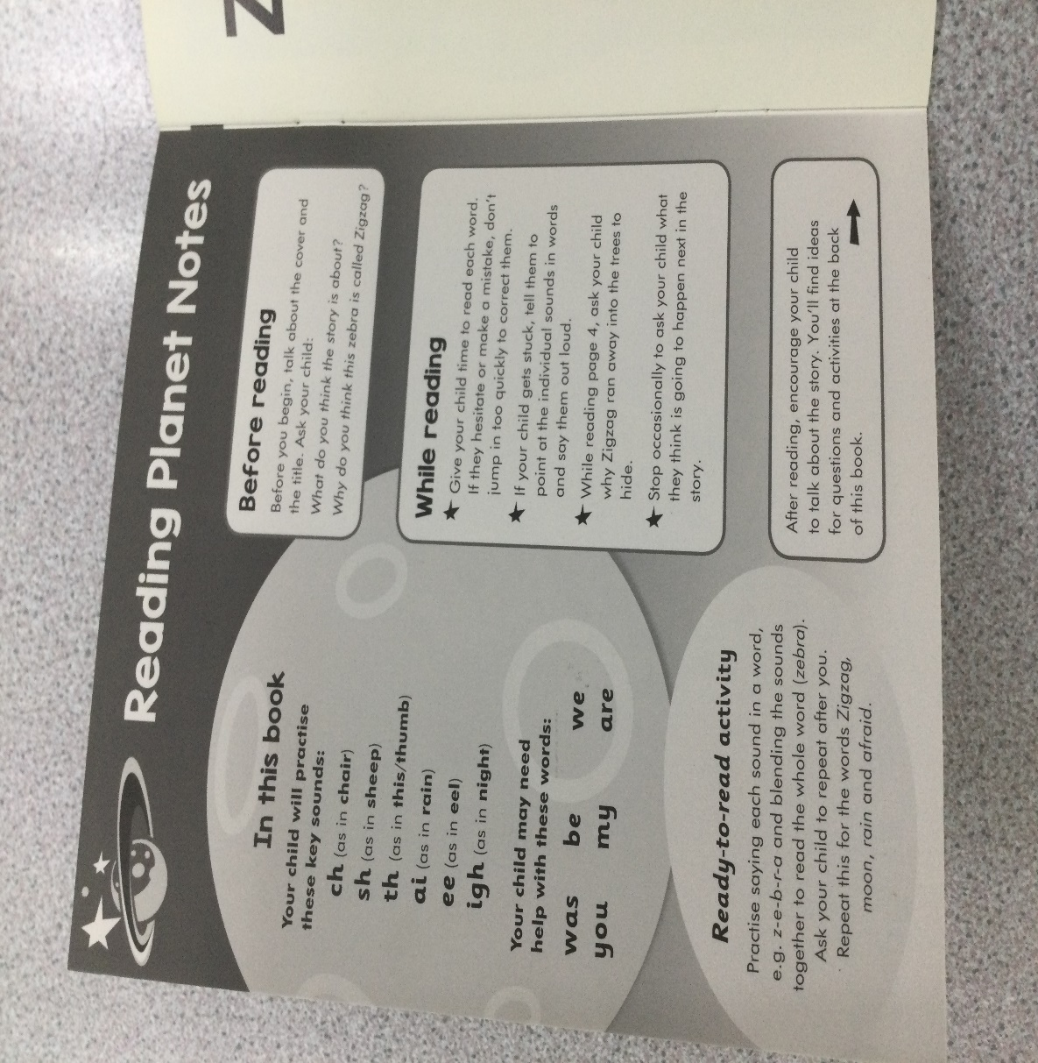
Top tip – inside the front cover of each book you will find a list of sounds featured within the text and the ‘tricky words’. This is a great way to begin reading the book by ensuring your child has retained these sounds and words before they begin reading.
The sounds in the front of the book are the sounds that we will have covered in phonics at school.

Slide 15
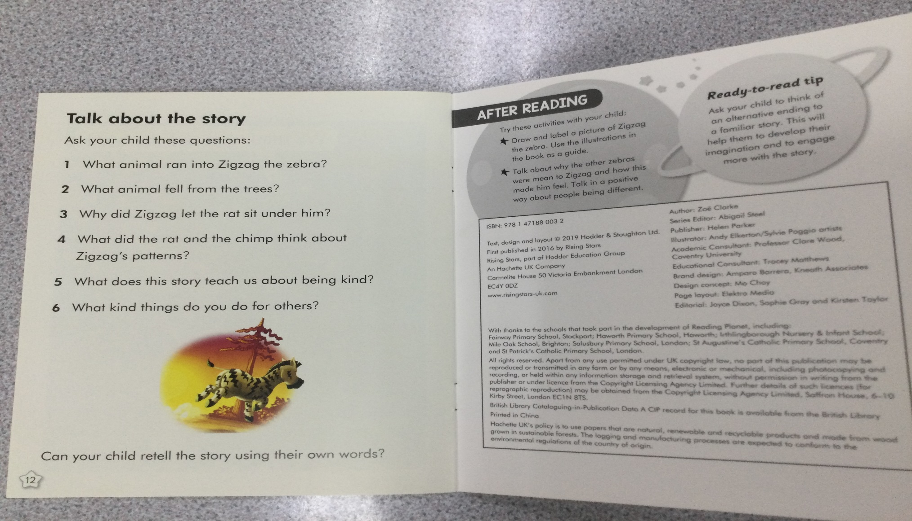
At the back of the book

Slide 16
Other reading books/ book banded books
In addition to the new Rocket Phonics reading book, we will also be sending home a book banded book.
These books are banded by difficulty but are NOT linked to the phonics scheme. So there will be words that the children are unable to read independently - please support them with this.
Please use these books as shared reading books for you and your child to read together.
It is important that the children are encouraged not to guess at words or to use the pictures to guess words. They should be using their phonic knowledge to decode if they can.

Slide 17
Reading
How can I help my child at home?
Just 10 minutes of reading each day makes such a difference in a child’s fluency, word recognition, pace and understanding.
It does not have to be a ‘reading book’, you can read ANYTHING ANYWHERE ANYTIME!!!
Any book experience is of value each and every day.

Slide 18
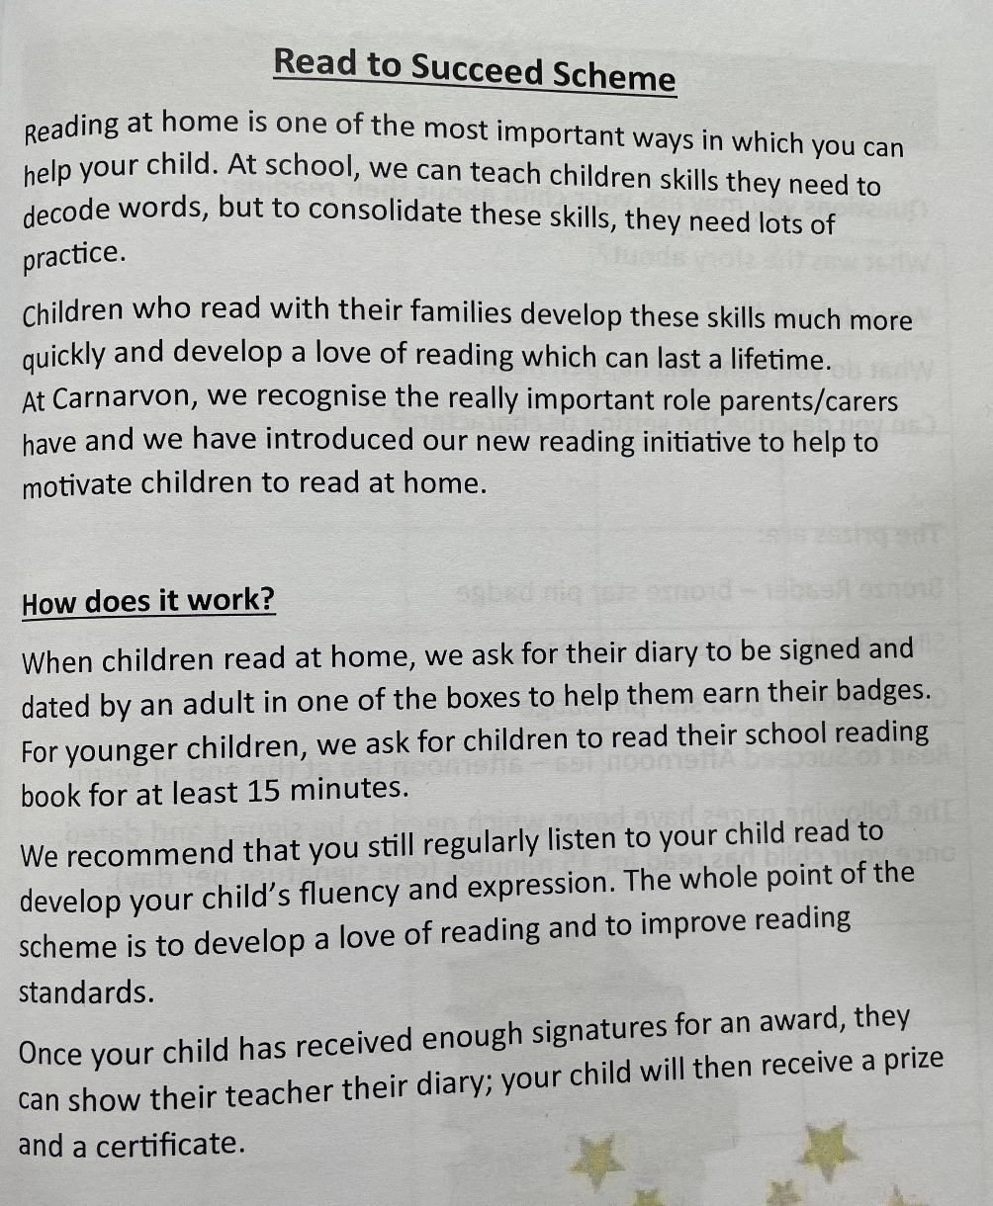
Read to succeed

Slide 19
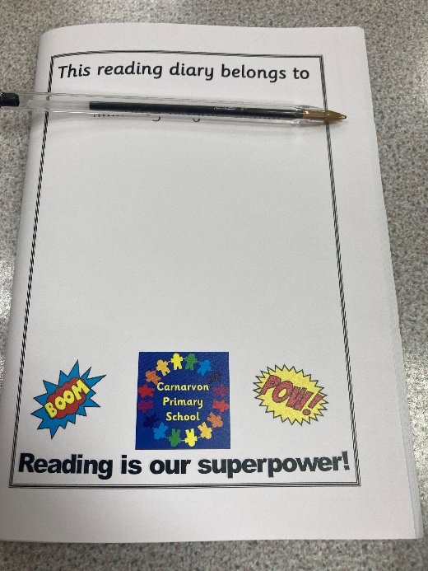
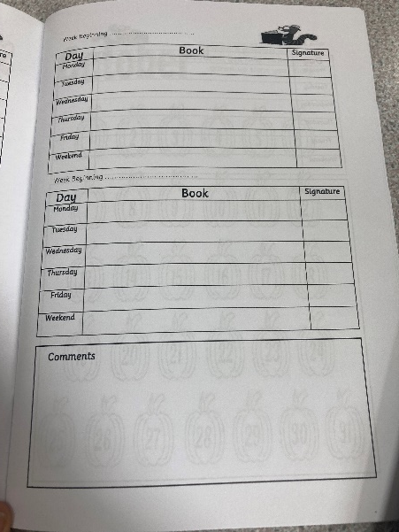
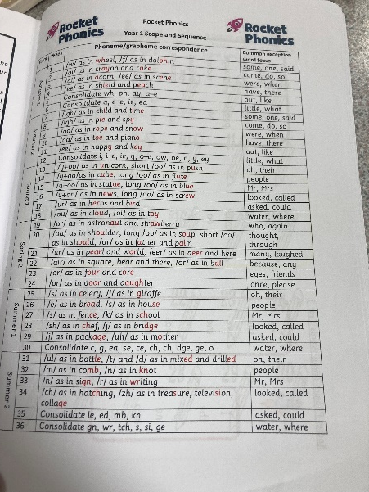
Reading diaries

Slide 20
Reading diaries
Including year 1 scope and sequence.
Reading reward chart.
Recording record/comments.

Slide 21
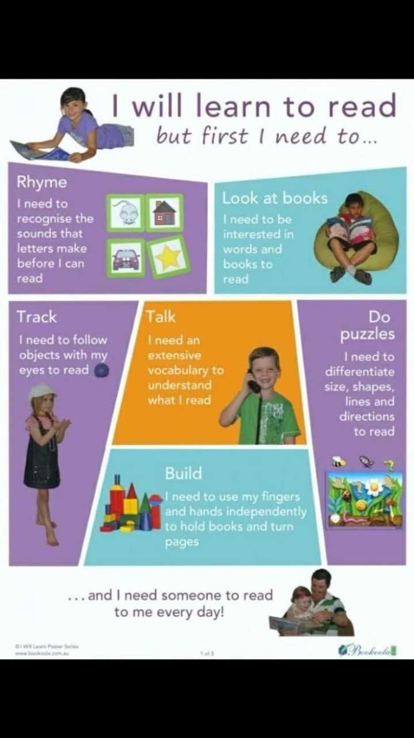

Slide 22
Writing
Establishing a good pencil grip – we call this using the froggy legs.
Correct letter formation- we teach these through letter families. Encourage your child to start at the top of most letters. (on the class page of the website)
Encourage children to write their own name accurately
When children are beginning to write at home or at school we encourage a ‘have a go’ approach rather than correcting every spelling.

Slide 23
Topics
Our main themes throughout the year include:
Childhood
Bright lights, big city.
School days.
Seasons.
Plants and animals.
Materials and human senses.

Slide 24
PE
Wednesday
The children will be wearing their kit all day. Please can you bring in a change of socks and shoes, in case of wet days. The smallest bag possible, for example a plastic bag is best for hanging on their pegs.
Hair to be tied back
Earrings to be removed or plasters applied
If dry, PE will continue outside all year- so warm winter clothing would be best
e.g. tracksuit top, jogging bottoms, trainers

Slide 25
School Website
E-Safety
Website with links to information about out topics, newsletters, calendar and photos.
Useful websites are listed.

Slide 26
Trips and visits
In December we will be visiting the Pantomime in Newark. More details to follow.
We usually go to Manor Farm in the summer.
We have walks into Bingham to visit the library.

Slide 27
Start/ End of the school day
Please encourage your children to come into the classroom independently carrying their own belongings.
To ease separation anxiety it is really helpful if you could leave your child as soon as possible.
If there are any concerns or any information you need to tell us about your child then please could we ask that you either send an quick email or write a note.
If you do need to pass a message on to a member of staff at the door about your child feeling unwell, please do this without your child in ear shot.
Please look at the weather forecast as we tend to go outside in all weather conditions! E.g. caps in summer alongside raincoats for showers.
A spare pair of socks or tights are helpful to be kept in book bags in the winter also.
Please encourage your children about how to zip up or button up their own coats, this really helps their independence.
Blowing noses practise!
End of the day
Please can you stand in a regular position where your child and staff member can see you. It is really helpful if you can wave when you see your child. Also please could we ask that parents stand a little way back from the door as we all find it easier to see faces when there is more space.
Please encourage your child to not play/climb on any of the school equipment as you leave the school site.
It is really important we let all of the children out safely at the end of the day before we can speak to any parents or adults collecting. Please wait until you can see that all of the children have been dismissed before trying to talk to a member of staff.

