Slide 1
“Meet the Teacher”
Year 6
Monday 21st July 2025

Slide 2
Welcome to the Y6 Team
Mrs Cartwright
6C, Deputy Head/Upper school lead (Y4-6)
Mr Hall
6H, subject leader for PE and Maths
Mrs Tupholme, Miss Flowers, Mrs Johnson and Miss Waite teaching assistants with responsibility for class cover, intervention programmes and small group work

Slide 3
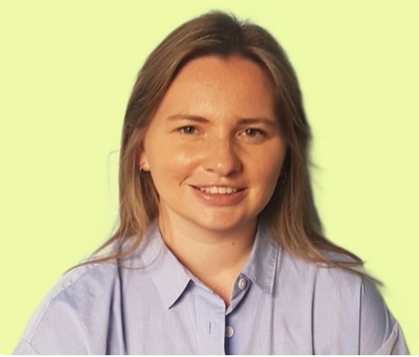
Welcome to the Y6 Team
Aslockton Primary
-Year 3 and 4 Class Teacher
- P.E lead
Heathfield Primary
-Year 2, 3, 4 and 5 Class Teacher
-Deputy Maths Lead
-English Lead (two sites)
-Teaching and Learning Lead
Whitemoor Academy
-Year 4 Class Teacher (3 years)
-Year 6 Class Teacher (3 years)
-English Lead
-Reading and Writing Improvement across the Trust
-School Assessment Lead
Carnarvon Primary
6C, Deputy Head/Upper school lead (Y4-6)
Mrs Cartwright

Slide 4
Outline of the Year
Autumn Term 1: History topic – Maafa (this project teaches children about Africa, exploring Britain’s role in the Transatlantic slave trade).
Autumn Term 2: Geography topic – Frozen Kingdoms (climate, flora & fauna etc of Arctic and Antarctic regions)
Spring Term: History topic - Britain at War (focus on World Wars I & II – causes, events and consequences)
Summer Term: Food for Life (healthy eating, processed foods and bread-making)
Our Changing World (maps, co-ordinates and time zones)
(plus SATs, end of year show, Sports Week and Duke’s Barn)

Slide 5
Classroom Routines
Maths: daily in two target groups - to include weekly arithmetic sessions
English: daily. 3 x themed lessons plus targeted Comprehension and SPaG
Reading: daily class book before lunch and silent reading after lunch
Science, Topic (History/Geography), Music, French, RE, Art, PSHE, ICT, PE taught across the year
Y6 responsibilities: Lunchtime Helpers, Wet Break Monitors (on a rota), Play Leaders, Sports Ambassadors, School Councillors, Peer Mentors

Slide 6
Homework
HOMEWORK WILL BE GIVEN OUT ON THURSDAY AND BE DUE BACK THE FOLLOWING THURSDAY
Maths: weekly (activities to support learning in school) – sometimes Mathletics, sometimes worksheet-based
English:
  Comprehension
  Punctuation and Grammar
  Spellings
Topic: occasional open-ended research projects
Reading: we encourage children to read regularly at home – please feel free to comment in your child’s planner and sign the Read to Succeed section

Slide 7
Expectations
Independence and responsibility, lead by example
Commendations/ table points/ raffle tickets
Lunch time tokens
Sanctions: ‘Ask, tell, warn, move, remove’
  Behaviour book
WORK HARD, BE KIND

Slide 8
PE
Kit to be worn on PE day (Mondays)
Blue Carnarvon t-shirt, black shorts, sports socks and activity-appropriate footwear
Earrings MUST be removed, hair tied back
To include tag rugby (and other invasion games) dance, gymnastics, orienteering, athletics & volleyball

Slide 9
‘PSHE’
Autumn 1: One World – citizenship
Autumn 2: E-Safety
Spring 1: VIPs
Spring 2: Think Positive
Summer 1: DAaRT – drug, alcohol and resistance training
Summer 2: Growing Up

Slide 10
Planners
Home/School agreement
Daily use
Parent / teacher signature weekly
Please encourage children to make regular use of them:
    Private reading (Read to Succeed)
    Key dates and deadlines
    Club dates
Use for notes or messages to staff

Slide 11
Newsletters & Communication
Refer to Y6 page on the website for termly information
Weekly newsletters for the whole school via email
Weekly newsletters are always on the school website
‘Parents Evening’ dates: TBC for November & March
Duke’s Barn/E-Safety/SATs information meeting:
TBC - January 2026
SATs: 11th – 14th May 2026
Dukes Barn: w/c 8th June 2026

Slide 12
The ‘S’ word!
w/c 11th May 2026
Tests: Reading comprehension; Spelling, Punctuation and Grammar; Arithmetic and Maths Reasoning
Target groups in Comprehension and Maths from September 2025
Parent information session: January 2025
CGP Revision guides to buy from The Office
Booster groups – 5 after school sessions in 2026

