Slide 1

Reception
Phonics, Reading and
Writing
Information for parents

Slide 2
Aims
What comes before the sounds?
The Early Learning Goals for Literacy
What is Phonics?
Saying the sounds and how not to do it!
Rocket Phonics
Reading
Writing

Slide 3

"If children know eight nursery rhymes
by heart, by the time they are four years
old, they're usually among the best
readers by the time they are eight.”
Mem Fox - Reading Magic

Slide 4
Early Learning Goals - Literacy
Comprehension
Children at the expected level of development will:
demonstrate understanding of what has been read to them by retelling stories and narratives using their own words and recently introduced vocabulary;
anticipate – where appropriate – key events in stories;
use and understand recently introduced vocabulary during role-play and in discussions about stories, non-fiction, rhymes and poems.
Word Reading
Children at the expected level of development will:
say a sound for each letter in the alphabet and at least 10 digraphs;
read words consistent with their phonic knowledge by sound-blending;
read aloud simple sentences and books that are consistent with their phonic knowledge, including some common exception words.
Writing
Children at the expected level of development will:
write recognisable letters, most of which are correctly formed;
spell words by identifying sounds in them and representing the sounds with a letter or letters;
write simple phrases and sentences that can be read by others.

Slide 5


Slide 6

Using ‘Pure Sounds’
Why does it matter how the sounds are pronounced?

Slide 7
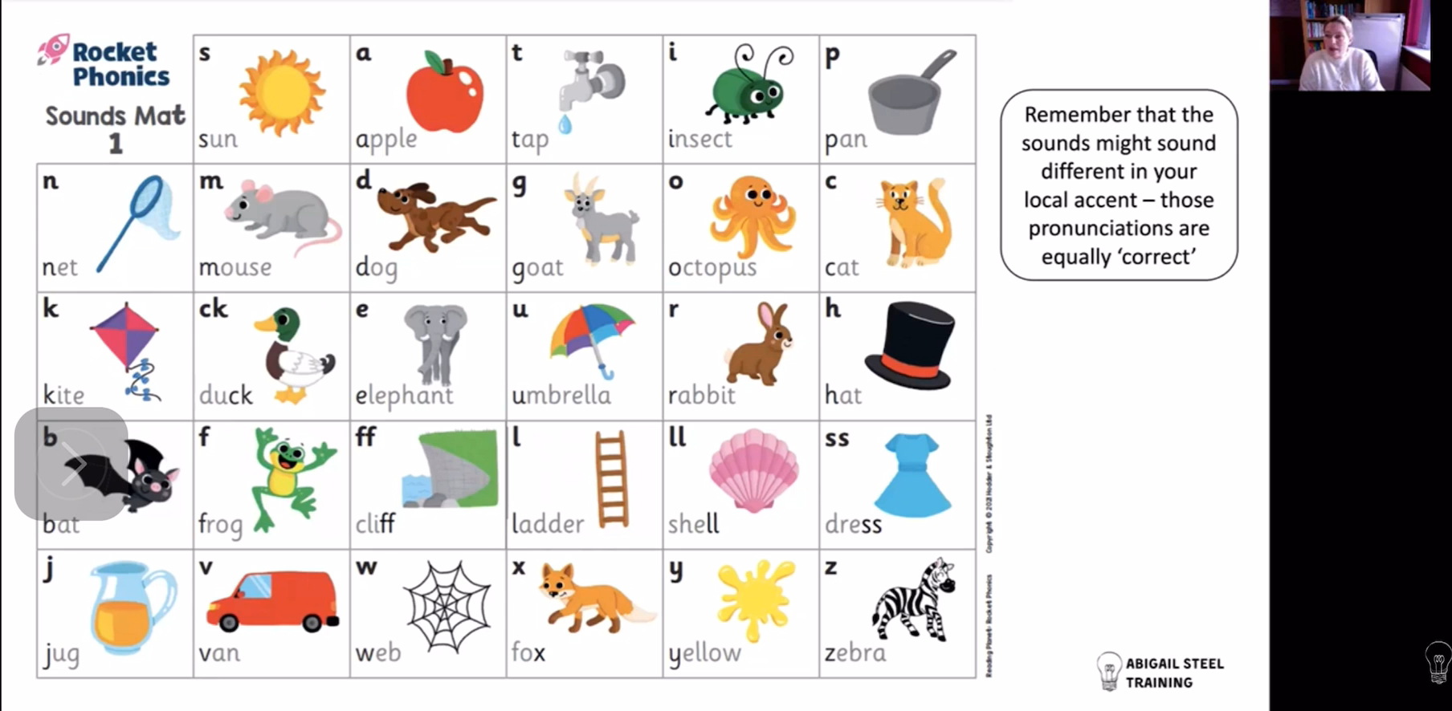

Slide 8
Phonics - blending
Comprehension
Reading
Common Exception Words

Slide 9
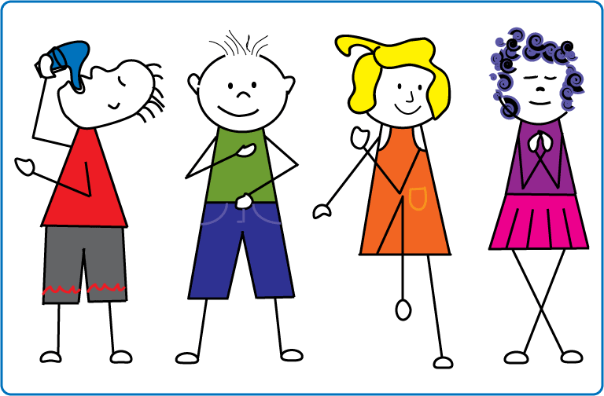
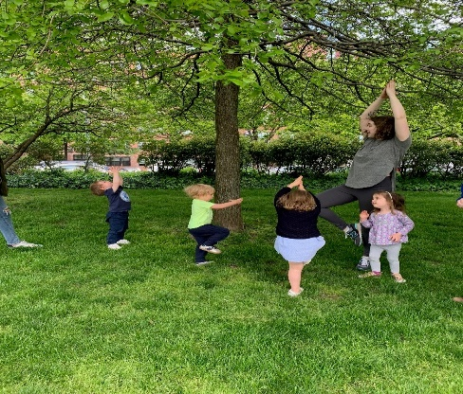
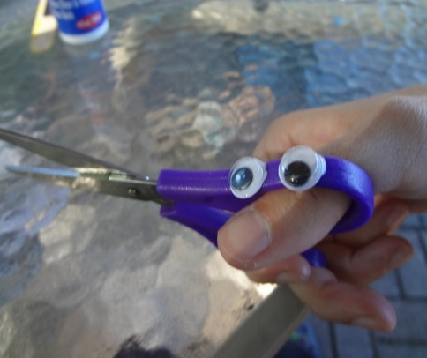
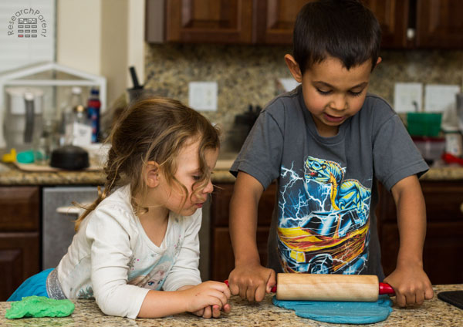
Pre writing exercises
We have to get our bodies ready for writing by developing our core strength and practising exercises that cross our mid-line (the vertical line down our bodies)

Slide 10
Writing
Phonics -segmenting
Pencil Grip
Letter Formation
Punctuation
Grammar
Ideas

Slide 11
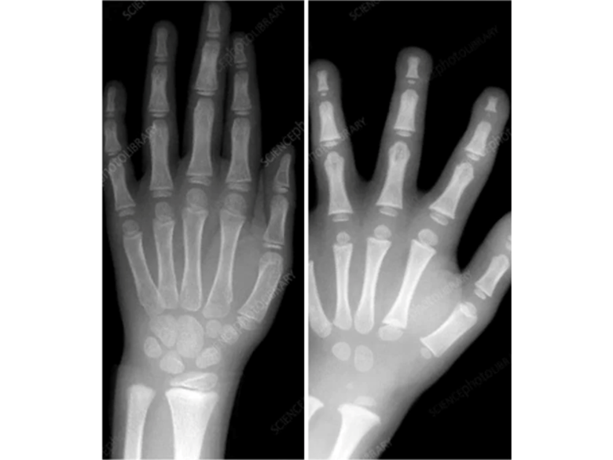
When are children’s bodies ready for Writing?

Slide 12
Letter Formation Families

Slide 13


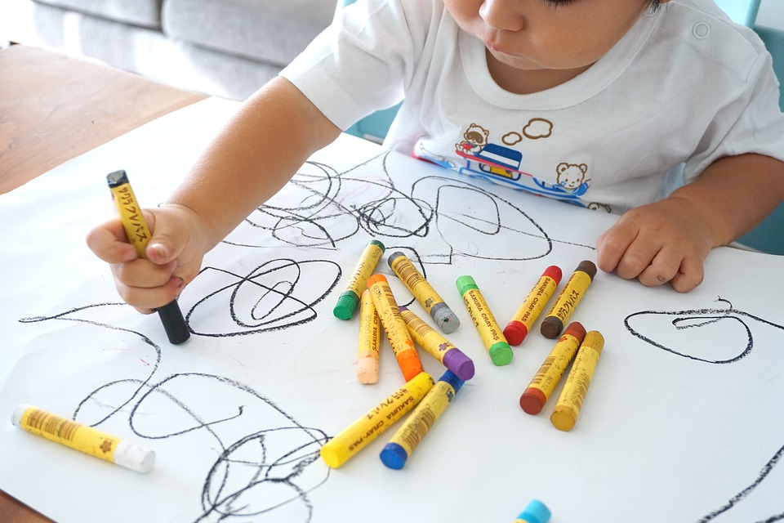
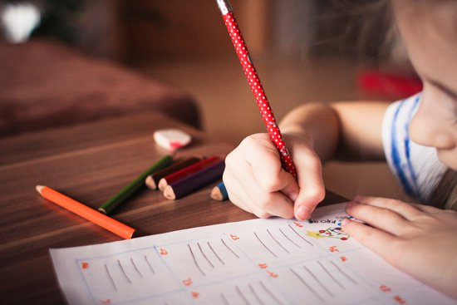
Being four and five and trying to write,
there are just too many things to think about!
It is up to us adults, to give children the confidence to just ‘have a go’

Slide 14
Thank you for your support.
The Reception Team

